Slide 1
Computational Geometry
Advanced Algorithms Mark Floryan CLRS Ch. 33 and some outside readings

Slide 2
Introduction

Slide 3
Part 2: Computational Geometry
Some more advanced CG algorithms:
- Finding the Convex Hull - Using the Quad-Tree data structure

Slide 4
Convex Hull

Slide 5
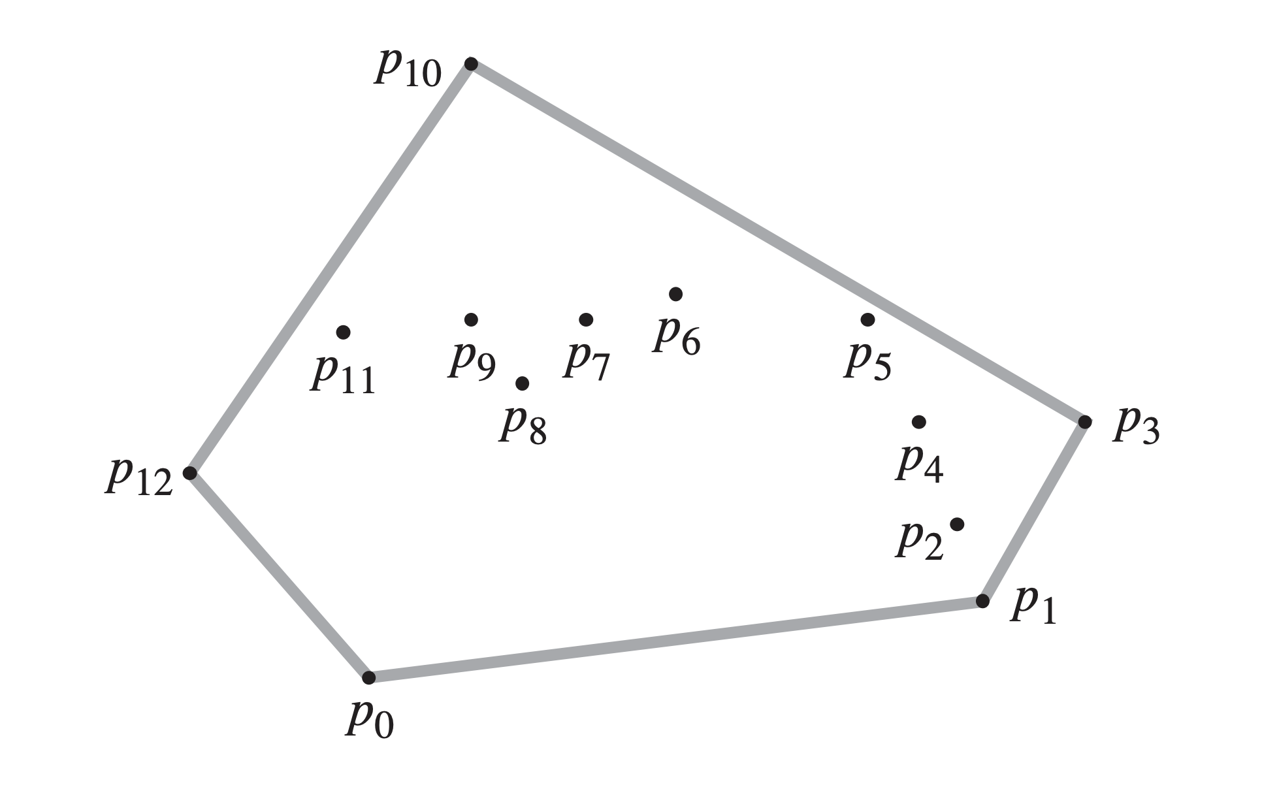
Convex Hulls
Convex Hull: Given a set of unique points Q, no three of which are colinear, the convex hull is the smallest convex polygon in which every point in Q is on are inside the hull.
In other words: The polygon you would get if the points were “pins” and you stretched a rubber band around the exterior of the points.
Applications:
- Collision detection for complex shapes - Magic-Wand tool in photoshop - Area of rainfall when viewed from above
Remember that the points must be unique and no three can be co-linear

Slide 6
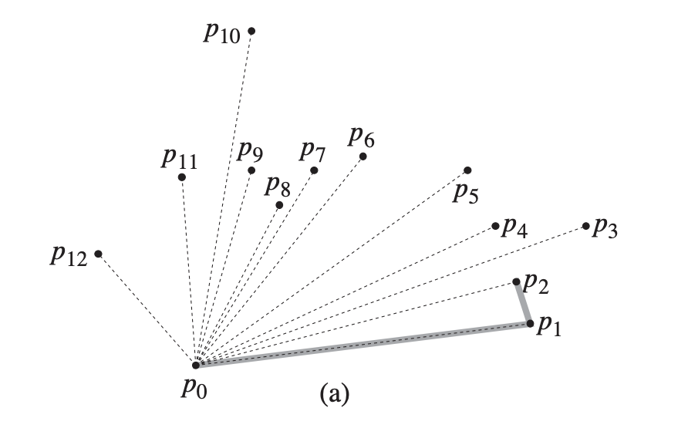
Convex Hull: Graham’s Scan
Graham’s Scan: is an algorithm that can compute the convex hull efficiently.
The algorithm performs a rotational sweep, starting at the lowest point and rotating around the points in counter-clockwise order.
Points are then ordered by increasing polar angle, relative to p₀
Algorithm will start at the lowest y-coordinate point (in this case, p₀)

Slide 7
Convex Hull: Graham’s Scan
As always, we need a key observation! What is the property we can exploit to find the next point that must be on the convex hull?
Idea: Look at the turn direction of next three points a, b, c
Point b is NOT on the convex hull if………

Slide 8
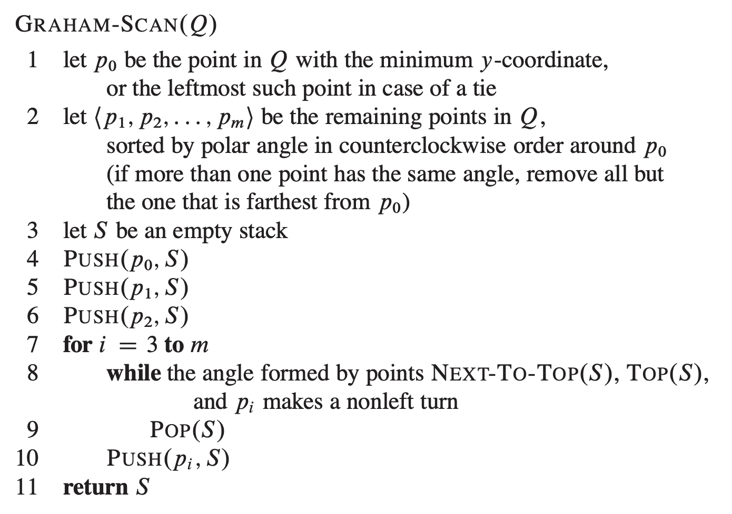
Graham’s Scan: Code

Slide 9
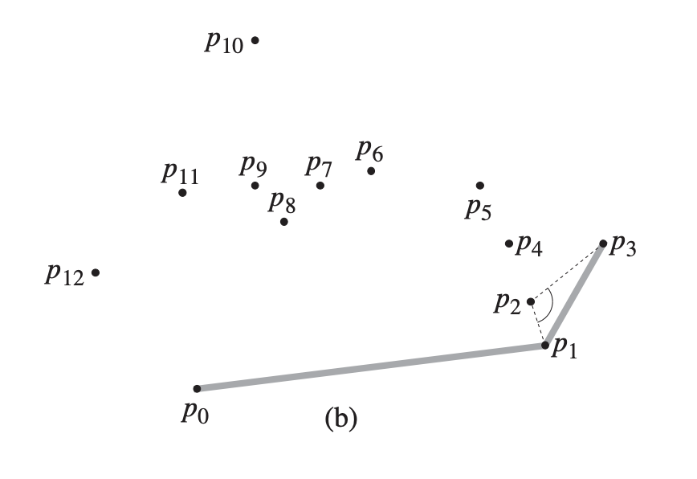
Graham’s Scan: Example

Slide 10
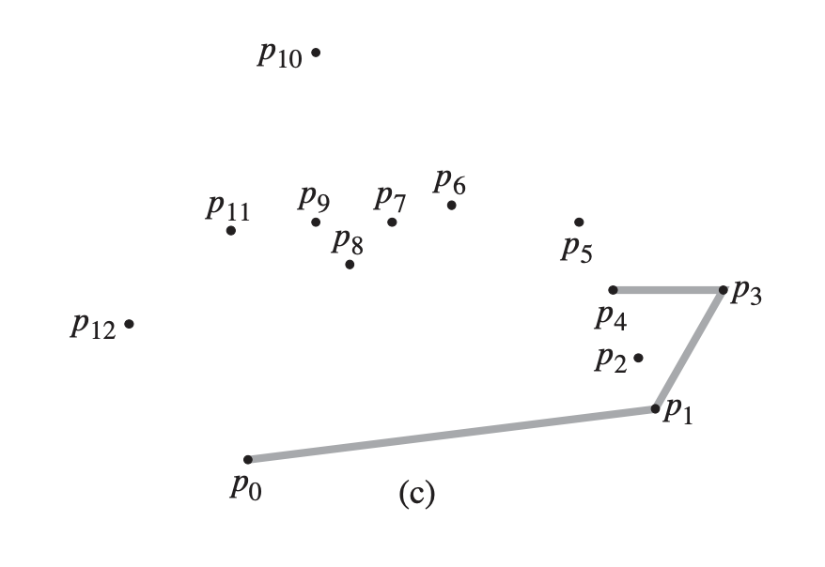
Graham’s Scan: Example

Slide 11
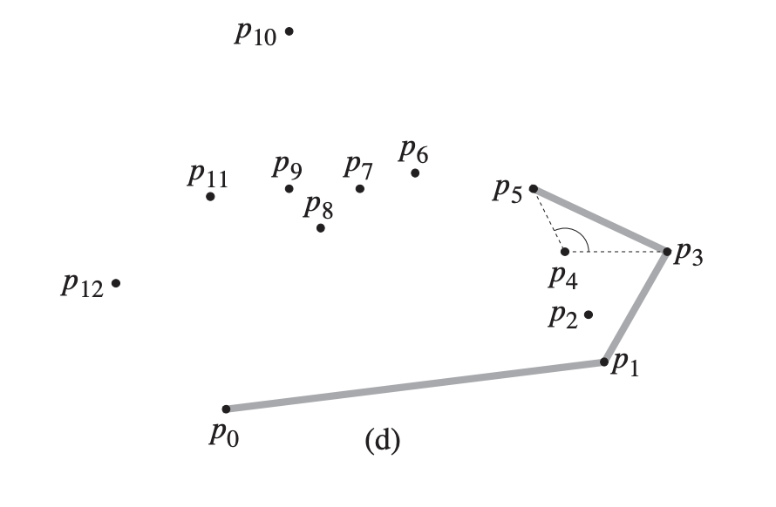
Graham’s Scan: Example

Slide 12
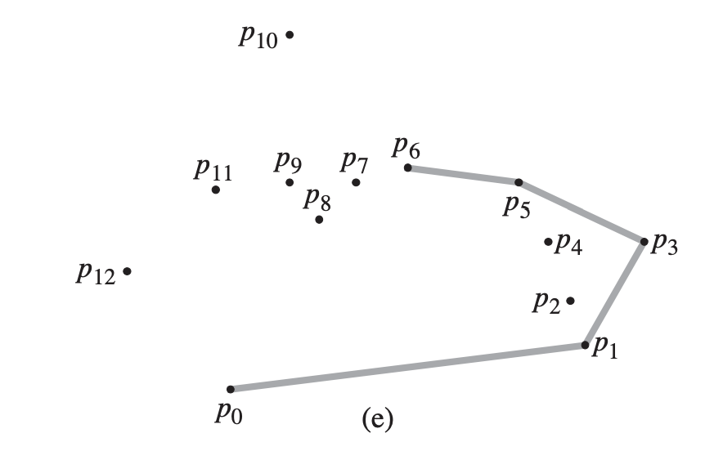
Graham’s Scan: Example

Slide 13
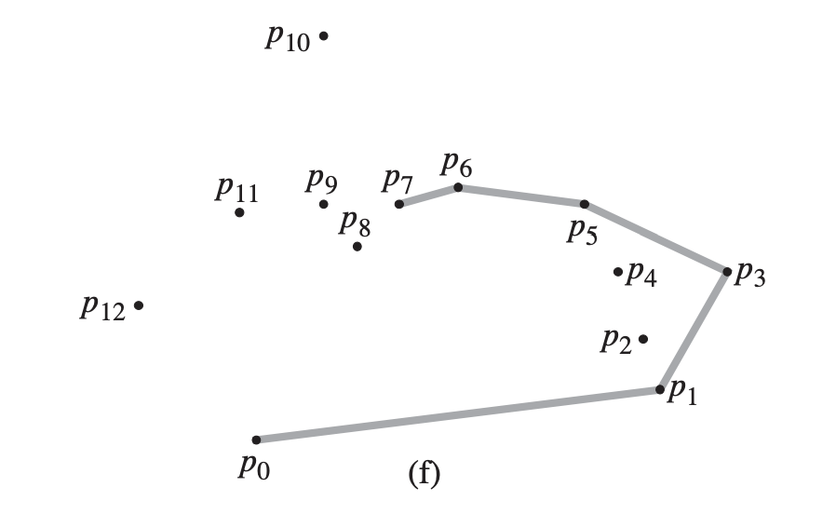
Graham’s Scan: Example

Slide 14
ASIDE: Farthest Pair of Points
Problem Statement: Given a set of points, find the two that are furthest away from one another.
Can you solve this problem?
Prove: The farthest pair of points must lie on the convex hull.

Slide 15
Quad-Trees

Slide 16
Problem: Keeping Track of Data Points
Suppose we work for a tech company (like Google maybe), and want the following functionality:
Given that cell phones are using maps and pinging their location regularly, we want to be able to store the x,y locations of users and support the following operations:
Insert(x,y): Insert a new point into the data structure
Delete(x,y): Delete a point from the structure
Get(p1,p2): Get the points that fall in the rectangle defined by upper left corner p1 and lower right corner p2

Slide 17
Traditional Data Structures Will Not Work
Why? Consider:
List: Hash Table: Binary Search Tree: Priority Queue:
Why won’t these work?

Slide 18
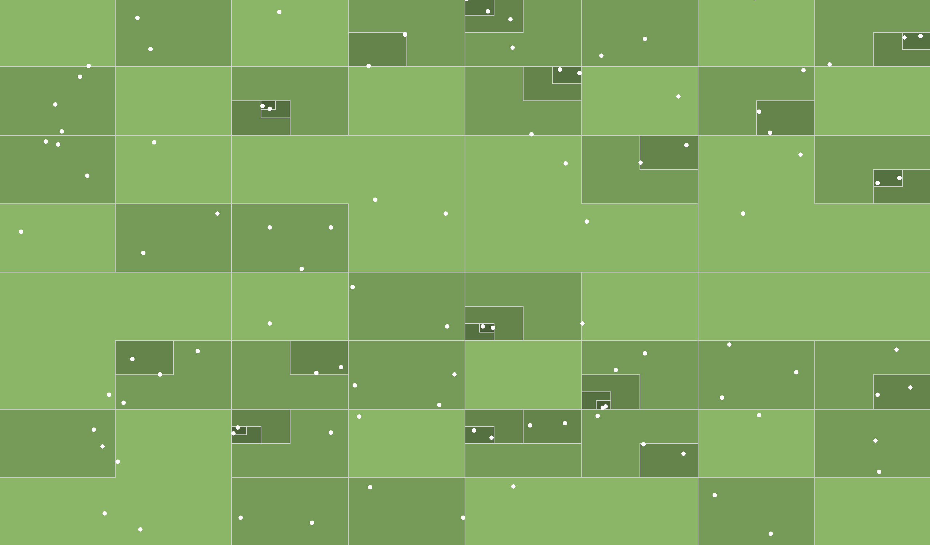
Enter the Quad Tree
The Quad Tree is a space partitioning data structure. Points are organized by splitting the overall plane into four sub-squares recursively
Each sub-square contains no more than four children.
Note that some nodes will have 0-3 children
Each “child” can be a point OR a sub-square (one quarter of this square)
*Source: https://jimkang.com/quadtreevis/

Slide 19
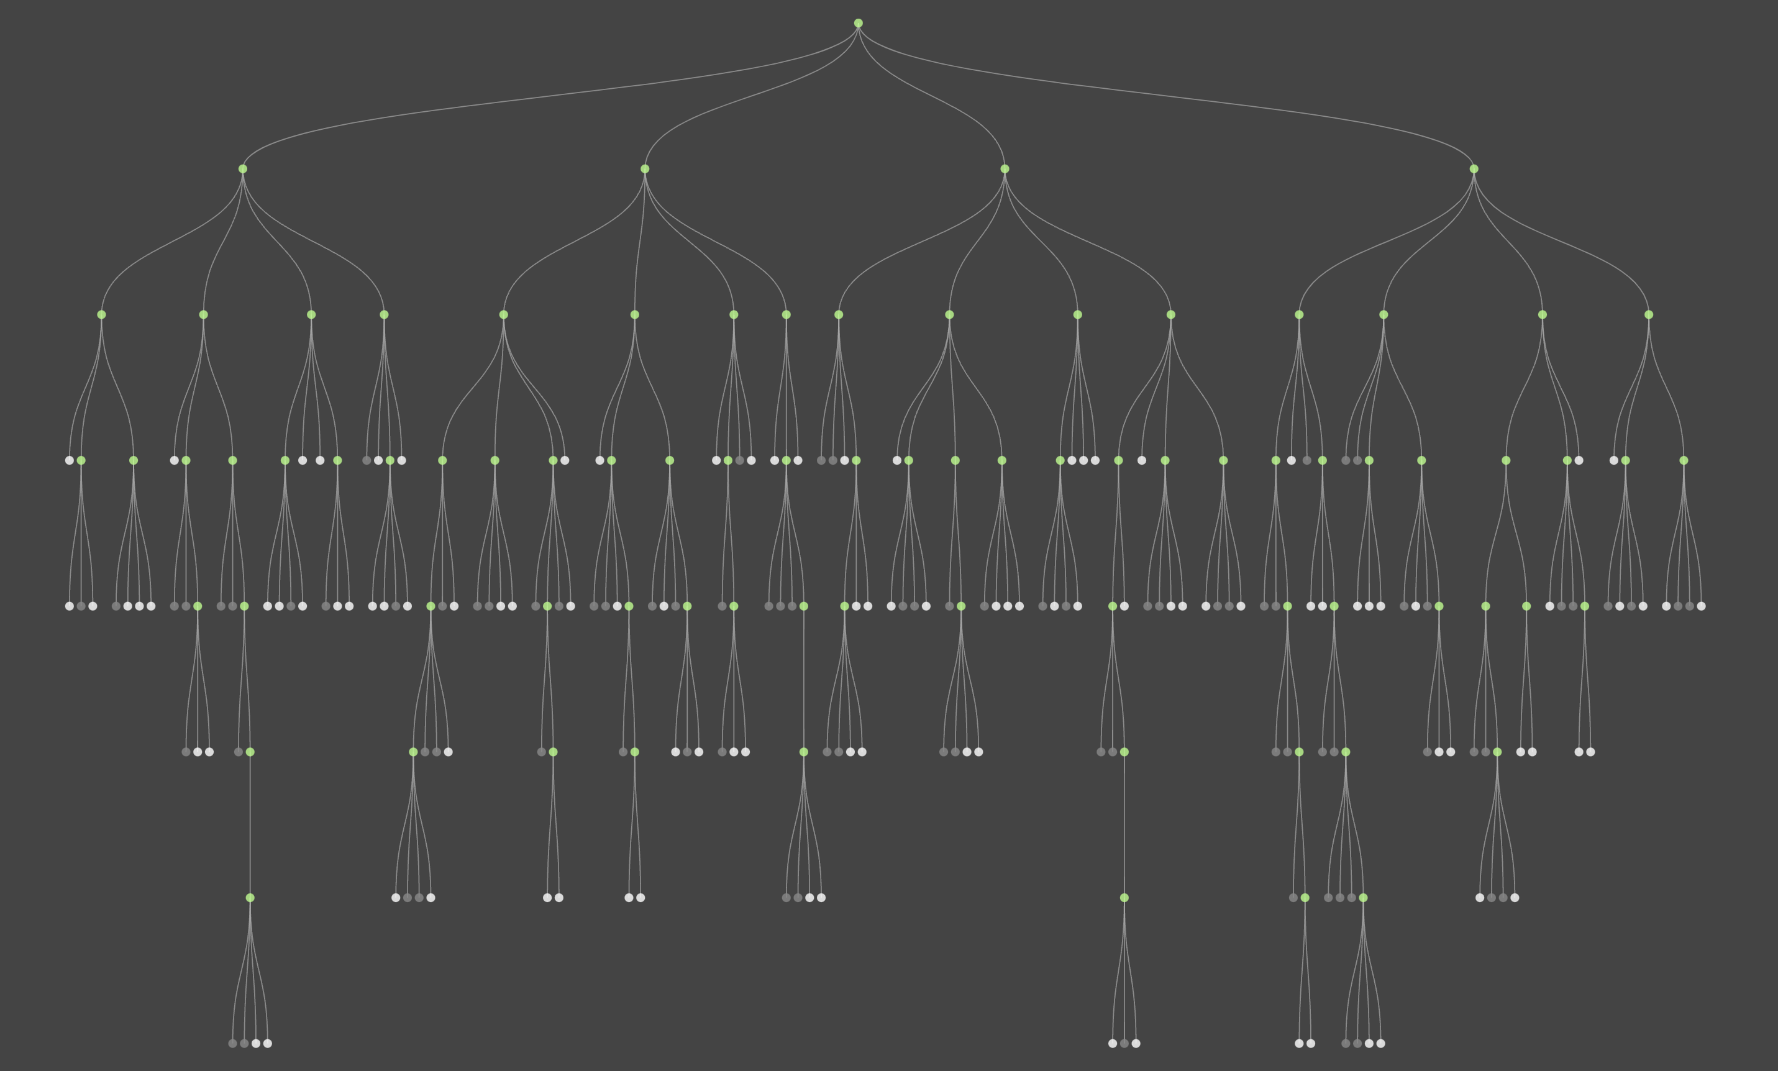
Enter the Quad Tree
*Source: https://jimkang.com/quadtreevis/

Slide 20
Building A Quad Tree
Quad objects store nodes of our tree
Some variables global to the DS
Object Quad:
/* Details of physical bounds for this quad */
Point topLeft;
Point bottomRight;
/* Points stored here (if leaf node only) */
Point[] data;
/* Children of this tree (null if not exists) */
Quad topLeftChild;
Quad topRightChild;
Quad bottomLeftChild;
Quad bottomRightChild;
Object QuadTree:
/* Root of the tree */
Quad root;
/* Maximum size of one dimension(e.g., 2⁹) */
Long maxCoordinate = pow(2,9);
/* Minimum length/width of a quad (e.g., 1) */
Long minSize = 1;
/* A single quad can only store up to this many points */
Int pointsPerQuad = 5;
Note: data XOR the quad children will be null. This is how you tell if leaf node or not

Slide 21
Quad Tree: Insert
Overall Idea:
Traverse the tree until you hit a quad with no data and no children. Insert the data (point) at this quad.
Issues:
Need to create quads that are null along the way as we go if THIS quad has any other children.
The leaf node you reach might already have a maximum number of points in it. Need to turn this node into an internal node and re-insert all nodes (the old ones and new one)

Slide 22
Insert Cases: Recursive Case 1
Black Node is being inserted
Upper right quad (sub-quad) already contains an internal node. Simply recurse on upper right quad
These gray nodes are null because they contain NO points

Slide 23
Insert Cases: Recursive Case 2
Black Node is being inserted
Lower right quad is null (has no points yet). So create that quad child first, then call insert on it
These gray nodes are null because they contain NO points

Slide 24
Insert Cases: Recursive Case 3
Black Node is being inserted
This quad has not been divided into sub quads yet AND already contains 5 points
What to do in this case? See next slide!

Slide 25
Insert Cases: Recursive Case 3
Black Node is being inserted
Figure which quads the six points are within and create them (some will be in the same quad)
Insert each point into the newly created quads. This case might repeat if all points are very close to each other

Slide 26
Insert Cases: Base Case 1
Black Node is being inserted
This quad has not been divided into sub quads yet AND does not have 5 points yet
Simply add the point to the internal list of points for this quad.

Slide 27
Quad Tree: Insert
insert(Point p):
/* Base Case */
If this quad is leaf node with < pointsPerQuad points
then add p to data
/* Recursive case 3: Another child already in leaf node */
If this quad contains exactly pointsPerQuad points
for each quad q’ containing each point p’ in {data} U {p}
create child quad for q’ if null
q’.insert(p’);
/* Recursive cases 1-2: Create sub-quad if necessary then insert */
If p falls in quad q that is currently null then create q
q.insert(p)

Slide 28
Quad Tree: Delete
Overall Idea:
Traverse the tree until you hit the quad that this node is contained within. This quad is guaranteed to be a leaf node with a constant number of points inside.
Issues to consider:
This quad should be deleted because if it now contains 0 points (so it shouldn’t exist). Delete object and set parent to point to null.
If this quad (post-delete) now has pointsPerQuad total points in children, then children should be merged into this one!!

Slide 29
Quad Tree: Delete Base Cases
delete(Point p):
/* Base Cases */
If this quad is null return //delete failed, point not in tree
If leaf node and p in data: delete p from data if data now empty, delete this quad
Base Case 1
Base Case 2

Slide 30
Quad Tree: Delete Recursive Cases
delete(Point p):
/* Base Cases from previous slides here */
…
/* Recursive case, find quad p is in */ Find sub-quad q that p is contained within q.delete(p) /* Details on next slide */ If this quad now contains pointsPerQuad points or fewer: merge sub-quads and convert this quad to leaf node

Slide 31
Checking If Merge is Necessary
Merge is only necessary if:
All four sub-quads of this one are leaf nodes AND the sum of the number of points is less than or equal to pointsPerQuad.
This can be checked in constant time:
sum = 0 For each quad q: If q is leaf node: sum+= q.data.size() else return //nothing to do

Slide 32
Merge Operation
Merge Idea: Set sub-quads to null and move points to this one.
For each child quad q: this.data.add(q.data) q = null

Slide 33
Quad Tree: Contains
Goal: Given a point, return True iff the point is in this quad-tree
Approach: Recurse into proper quads until you hit a leaf, then search data manually. Self-explanatory so we won’t say more than this here.

Slide 34
Quad Tree: Get Count By Area
Goal: Given a rectangular area (given by two points, upper left and lower right), return the number of points that fall within those bounds in sub-linear time
Uses: Grabbing number of nearby users for a social application. Computing traffic data based on location. Computing “busy areas” versus not busy areas. Etc…
Overall Idea: Traverse the tree and keep track of the area you want to get points within. Keep shrinking until range we hit leaf nodes of tree.
Issues to consider:
Range spans multiple quads (This is the biggest issue to consider)
Calculating a “new” range when recursing into a quad.

Slide 35
Example: Get Count in Range
Black Nodes are already inserted into the tree
We want to return the points in this given range (provided as a parameter. Return value should be 5 points
This gray nodes are null because they contain NO points

Slide 36
Get Count: Base Cases
int getCount(Quad *root, Rectangle area);
Quad is null: There are no points in a null quad, so just return the empty list.
Quad is leaf node (contains pointsPerQuad point only): Check if the constant number of points are within the bounds of ‘area’. Return the number that are within range.
No points, so always return empty list
One point, check if point inside of area

Slide 37
Get Count: Recursive Case
int getCount(Quad *root, Rectangle area);
If this quad is internal node: - Compute which sub-quads the rectangle area intersects with. - Compute sub-rectangles such that each falls completely within one sub-quad - Recursively call getPointsByArea on each sub-quad with each respective sub-area. - Union the return values together (just add them up!).
There is one MAJOR problem with this approach (which we will fix soon). Do you see it?

Slide 38
Get Count: Recursive Case

Slide 39

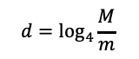


Quad Tree: Analysis
Some Variables of interest:
M
Maximum world size (assume 2^{c} for some integer c for now)
m
Minimum world size (assume 2^{c’} for some c’ < c)
n
Number of points that could be added at most to the quad-tree
$$d=\log_{4}{\frac{M}{m}}$$
Maximum depth of the quad-tree
Some Variables of interest:
insert
Runtime is $Θ\left(d\right)$
delete
Runtime is $Θ\left(d\right)$
getCount
Runtime is $Θ(n)$ **Uh oh! Why? How do we fix this? Let’s fix it now!

Slide 40
Why is get Count Linear Time?
If the area we are querying is the entire “world”, then we will recurse four times on EACH internal node, leading to a linear running time.
Fix: if the area is ENTIRE quad, just return the answer directly!

Slide 41
Updating Quad Tree
Quad objects store nodes of our tree
Considerations
Object Quad:
/* Details of physical bounds for this quad */
Point topLeft;
Point bottomRight;
/* Points stored here (if leaf node only) */
Point[] data;
int count; //Store full count of nodes
/* Children of this tree (null if not exists) */
Quad topLeftChild;
Quad topRightChild;
Quad bottomLeftChild;
Quad bottomRightChild;
Need to update this count while recursing during insert and delete methods (easy to do)
getCount() needs a new base case. If query area is entire quad area, just return count;
Note that this works with ANY specific statistic on the points. Only requirements:
Requires a constant amount of storage
Can be easily merged: For example, if I know the count of two quads I can very easily figure out the count of one quad containing both (just add the counts together)
Is it fast? Well consider this:
Large query areas will hit a base case FAST because they will cover entire quads very early in the search (good!!)
Small query areas are more likely to fall completely in ONE quad and only recurse in one direction (FAST!)
Stores total number of points in this quad. Can return this if query area is entire quad!

Slide 42
Conclusion

Slide 43
Conclusions
Convex Hull: A nice example of a computational geometry algorithm that uses radial sweep approach. MANY applications in practice.
Quad Tree: A nice example of a data structure involving geometric / spatial data. Can be extended for fuller functionality.

